Slide 1
Noise, Interference and Grounding
By
Candida Nakida Mwisomba

Slide 2
Noise
We discussed about error sources that arise during the measurement process of sensing the value of a physical variable and generating an output signal.
However, further errors are often created in measurement systems when electrical signals from measurement sensors and transducers are corrupted by induced noise.
This induced noise arises both within the measurement circuit itself and also during the transmission of measurement signals to remote points.
Noise voltages can exist either in serial mode or common mode forms. Serial mode noise voltages act in series with the output voltage from a measurement sensor or transducer, which can cause very significant errors in the output measurement signal.

Slide 3
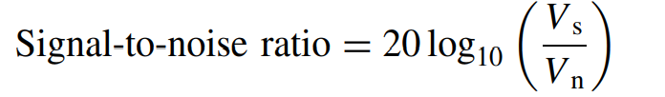
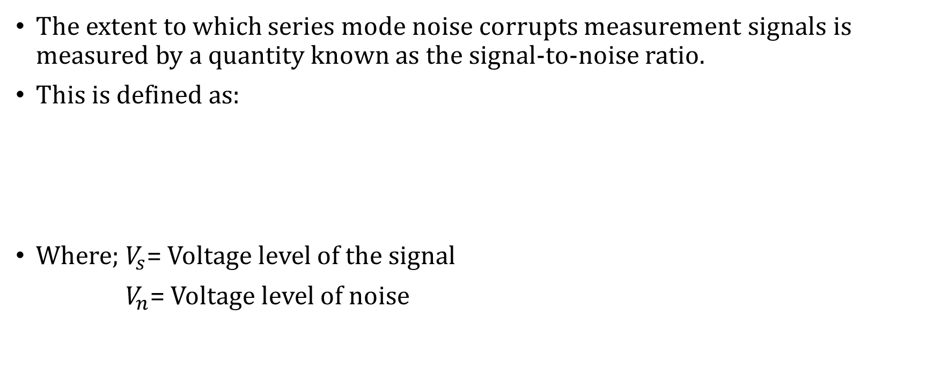
Noise…
The extent to which series mode noise corrupts measurement signals is measured by a quantity known as the signal-to-noise ratio.
This is defined as:
Where; $V_{s}$= Voltage level of the signal
$V_{n}$= Voltage level of noise

Slide 4
Noise…
Common mode noise voltages are less serious, because they cause the potential of both sides of a signal circuit to be raised by the same level, and thus the level of the output measurement signal is unchanged.
However, common mode voltages do have to be considered carefully, since they can be converted into series mode voltages in certain circumstances.
Noise can be generated from sources both external and internal to the measurement system.
Therefore Noise is the undesired electrical signal that is present apart from the measured quantity.

Slide 5
Types of noise
White Noise
Eg: Thermal and Shot Noise
Pink Noise
Eg: Flicker and Burst Noise
Atmospheric Noise
Eg: Lightening and EM radiations

Slide 6
Types of noise
Thermal noise is generated by the random motion of free electrons in a conductor resulting from thermal agitation.
The magnitude of the motion is proportional to the temperature of the conductor.
The random motion of the electrons constitutes a random current in the conductor and thus a random noise voltage appears across its terminals.

Slide 7
Types of noise
Shot noise normally occurs when there is a potential barrier (voltage differential). PN junction diode is an example that has potential barrier. When the electrons and holes cross the barrier, shot noise is produced.
For example, a diode, a transistor, and vacuum tube will all produce Shot noise. On the other hand, a resistor normally does not produce Shot noise since there is no potential barrier built within a resistor.
Current flowing through a resistor will not exhibit any fluctuations. However, current flowing through a diode produces small fluctuations.
This is due to electrons (in turn, the charge) arriving in quanta, one electron at a time. The current flow is not continuous, but limited by the quantum of the electron charges.

Slide 8
Techniques for reducing measurement noise
Location and design of signal wires
Earthing
Shielding

Slide 9
QUESTIONS
????

